Slide 1
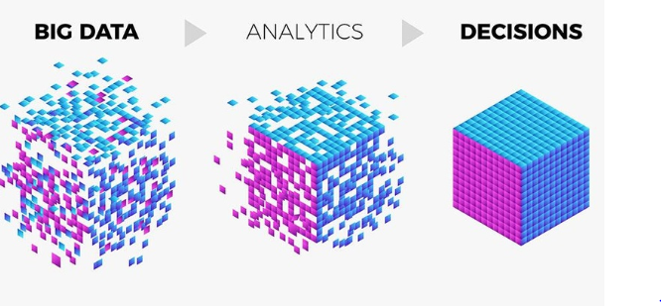
Group 9 – Big Data Project

Slide 2
Problem Statement & Objectives
Problem Statement
At Az National Trucking (ANT), a fictional national trucking corporation headquartered in California. We ensure that all the drivers in the fleet are in compliance with the rules and regulations of the corporation and do not present an insurance risk due to factors including speeding, unsafe following, lane departure, and other unsafe driving practices.
Objective and Insights
We used risk threshold (Event/TotMiles- Scaled) as the key performance indicator to classify the drivers as risky and not risky. These are some of our insights:
Out of the 8000 events recorded, about 94 percent were normal events and the rest 6 percent were indicative of unsafe driving practices.
All 99 unique drivers were recorded with at least one among the unsafe driving events.
Driver with ID A97 was classified as most risky based on our threshold. He has also super exceeded California speed limit
We found that miles driven had no correlation with the driver being risky
14 of the drivers were classified as risky and 85 drivers were classified as non-risky

Slide 3
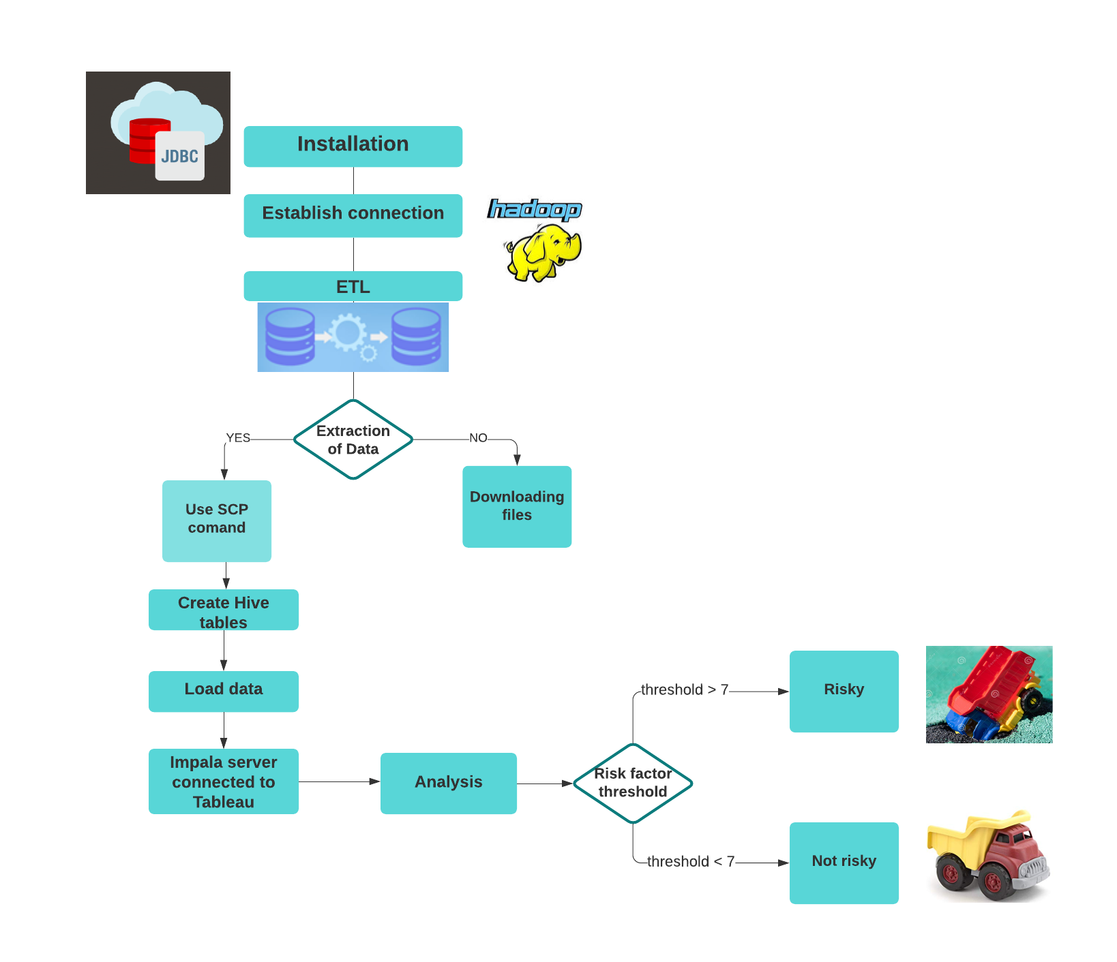

Big Data – Hadoop
•Install JDBC/ODBC drivers
•Integrate HDFS with Tableau via JDBC drivers for Impala
ETL on HDFS
•Split the dataset into individual text files
•Load individual data files into VM ware - used the scp command to transfer files onto HDFS
•Move these data files into HDFS using hdfs command
•Create tables on HIVE
•Load the data into HIVE by utilizing “LOAD DATA INPATH”
Reporting and Analytics with Hadoop and Tableau
•Risk Assessment of Truck Drivers

Slide 4
